Slide 1
On the way to Kindergarten! 2020-2021 School Year
Welcome
Families & Students
Please access further information by clicking on
the links provided in this presentation

Slide 2
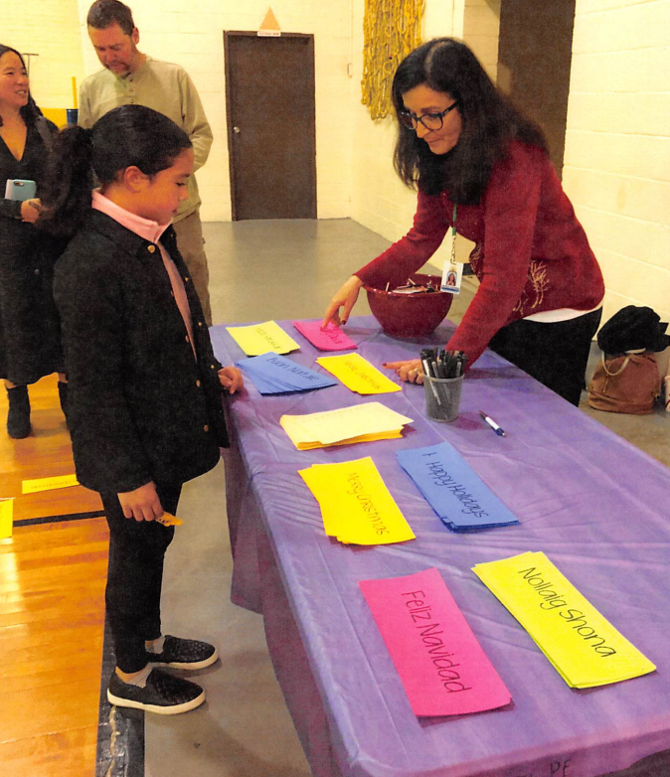
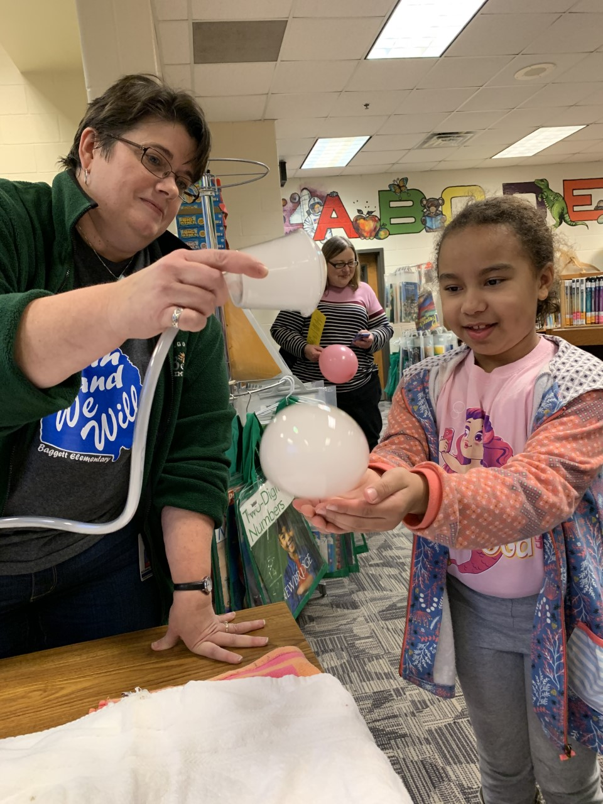
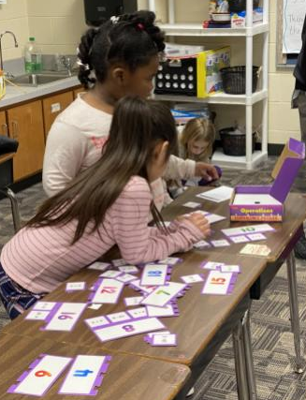
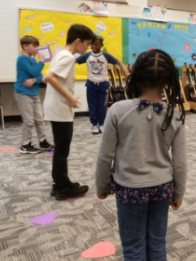
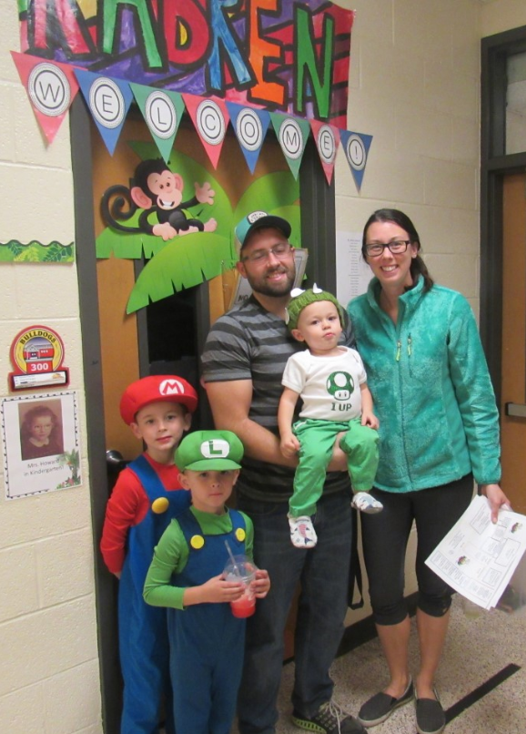
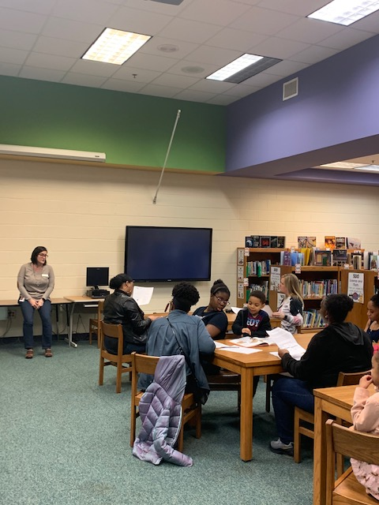
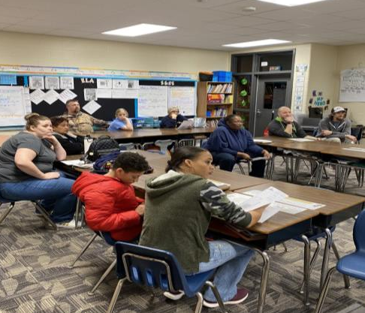
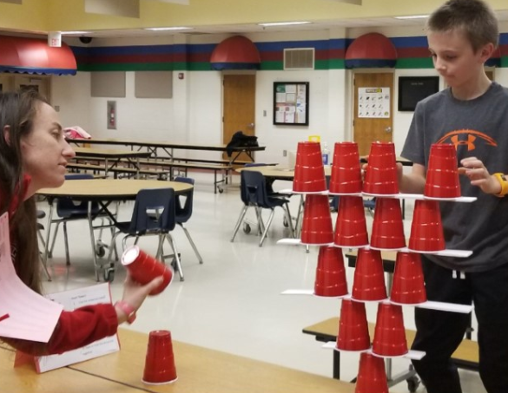
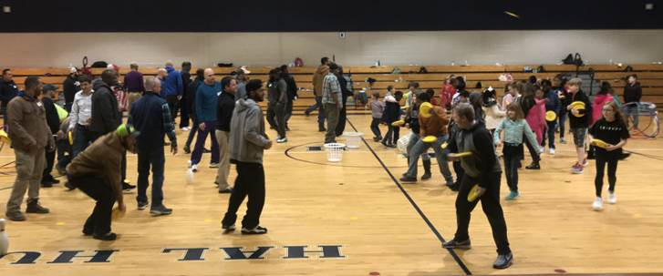

Slide 3
Information and Resources Available here

Slide 4
A typical Kindergarten Day
7:30-8:00 Arrival & Independent Activity
8:00 School Starts
8:00-8:10 Attendance & Announcements
8:10-9:10 Whole Group Reading & Language Arts (Bookworms)
9:10-10:00 Small Group Reading activities tailored for individual student progress
10:00-10:30 Science and Social Studies-integrated into reading and writing
10:30-10:45 Recess (Additional Power Breaks throughout day)
10:45-11:15 Lunch
11:30-12:15 Specials (PE, Music, Art, Media Center, Guidance, STEM)
12:15-1:15 Whole Group Math
1:15-2:00 Small Group Math activities tailored for individual student progress
2:00-2:15 Prepare for end of the day/Read Aloud
2:30 Dismissal
*order of events may differ from school-to-school

Slide 5
.
Breakfast & Lunch
Menus & other details available on Paulding County School District Website
Information available here.
Free & Reduced Lunch
information is sent home on the first day of school or during Open House
apply online at HeartlandApps.com
may take up to 2 weeks to receive notification of approval
everyone is encouraged to apply, even if not immediately taking advantage of opportunity
If purchasing meals
may be prepaid on child’s meal account online: www.myschoolbucks.com
with MasterCard or Visa
elementary students
Breakfast $1.40
Lunch $2.15

Slide 6
.
All families should complete a car-rider form
Includes details of who may/may not pick up your child, emergency contact numbers, and other information to ensure the utmost in safety for your child
Taking the bus?
find the school that serves where you live, and when and where the bus will stop to pick-up, drop-off students
Download: Here Come the Bus App
Information available here.
Please note that the information is subject to change for the 2020-2021 school year.
Getting to School
Bus?
Car-Rider?
Both?

Slide 7
.
Learning Bridge After School Program
in all Paulding County Elementary Schools
conforms to state regulations which govern daily operations
does not offer child care on daily or short term basis
Full Time
4-5 days/week @ $35 (2020-2021 rates)
Part Time
1, 2 or 3 days/week @ $21 (2020-2021 rates)
No drop-in or short term services available
Registration Fee:
$20/child or $40/family
Summer Camp
More details available at www.learningbridgepaulding.com
Private after school daycare, in school
Learning Bridge

Slide 8
.
A beginning of year event, usually taking place in mid to late afternoon before the first week of school. Watch for date and time to be posted on the PCSD website soon!
visit your child’s classroom and teacher
receive and complete beginning-of-year paperwork
visit school nurse, if needed
transportation staff may be available, if needed
opportunity to register with Learning Bridge
pay for school lunches
visit school parent resource center
meet school administration
20-21 School Year, Open House -----------@ 2pm-6pm
1st Day of School begins, August 3rd

Slide 9
Ready, Set, Go!

Slide 10
Social Skills
Cooperate with adults
Play and cooperate with other children
Share, and take turns
Sit for periods of time (15 minutes)
Understand and follow class rules
Understand and follow directions
Communicate wants, and needs
Able to take care of personal bathroom needs
How parents can support student-readiness:
Talk, Talk, Talk, Talk, Talk, Talk!

Slide 11
General Readiness in Academics
Developed interest in books, able to hold book and turn pages correctly
Identify labels and signs in environment
Use crayons, pencils, scissors, glue
Express ideas in drawings
Identify basic colors:
red blue green yellow purple brown black white pink orange

Slide 12
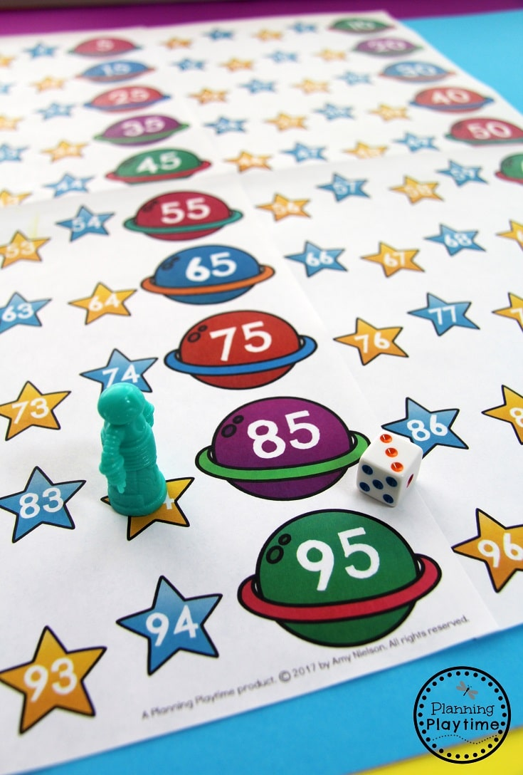
General Readiness in Academics
Begin to identify letters of the alphabet
Print first name, using capital and lower case letters
Tell about an experience
Identify shapes: square circle oval rectangle triangle rumbas (diamond)
Count to 20 by ones
Recognize groups of 1, 2, 3, 4, and 5 objects
Begin to identify numbers– 0 to 10

Slide 13
What will my child be learning?
View Kindergarten learning outcomes here.

Slide 14
Literacy
Naming upper and lower case letters, matching letters with their sound, and printing them
Comparing the adventures and experiences of characters in familiar stories, such as fairy tales and folk tales
Retelling familiar stories and talking about stories read to them using details from the text
Using a combination of drawing, dictating, and writing to describe an event, including his or her reaction to what happened
Stating an opinion or preference about a topic or book in writing; for example, “My favorite thing about the story is…”
Supporting your child at home: read, read, read, read…talk, talk, talk, talk…

Slide 15
Literacy
Taking part in classroom conversations, and following rules for discussion (Turn-n-Talk strategy, etc.)
Speaking clearly to express feelings, thoughts, and ideas, including descriptions of familiar people, places, things, and events
Asking and answering questions about key details in stories or other information read aloud
Understanding and using question words in discussions
Learning to recognize and spell sight words
Supporting your child at home: read, read, read, read….talk, talk, talk, talk…

Slide 16
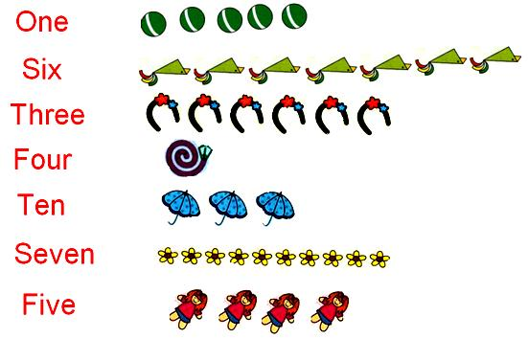
Math
Counting objects to tell how many there are
Comparing 2 groups of objects to identify which group, if either, has more or less; comparing 2 written numbers to tell which is greater or lesser
Addition with a sum of 10 or less; subtracting from a number 10 or less; solving addition and subtraction word numbers
Adding and subtracting small numbers quickly and accurately, such as 3 + 1
Correctly naming shapes regardless of orientation or size
Supporting your child at home: count, sort, measure...talk, talk, talk, talk…

Slide 17
Measuring my child’s progress Full information is available here.
Year begins with a “Readiness Assessment” that takes place within the first 6 weeks of school that helps identify level of student knowledge so that teachers can determine the “next-steps” of teaching and learning for each student
Then, GKIDS is launched. This is a year-long, performance-based assessment aligned to the state mandated content standards.
Provides teachers with information about the level of instructional support needed by individual students throughout the Kindergarten year for successful transition to First Grade.

Slide 18
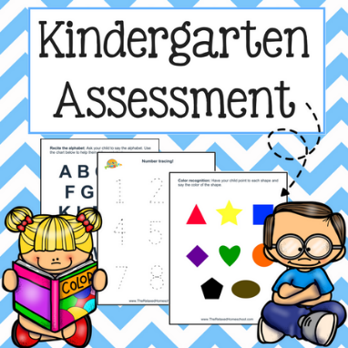
Measuring my child’s progress
Throughout the year, teachers assess students, and record GKIDS data (these are Formative Assessments that help determine next-steps for teaching and learning throughout the year)
This provides information on each child’s development in Language Arts, Math, Personal/Social Development, & Approaches to Learning.
At the end of the year, summary reports and individual student reports are generated, based on the data the teacher has entered throughout the year (this is called a Summative Assessment)
This includes scores in Language Arts, which includes reading, writing, and speaking skills, & Math. These scores serve as an indicator of First grade readiness.

Slide 20
Read
Read WITH your child every day!
Have your child see YOU reading for your own pleasure.
Have books available in your home.

Slide 21
Talk with your child A LOT!
Encourage your child to tell you about his or her day.
Let your child hear you talk,
A LOT.
Keep paper, markers, or crayons around the house for your child to write letters or words to draw a picture about his or her day. Have your child describe the picture to you.

Slide 22
PLAY with WORDS
Play word games like I Spy, sing songs, and make silly rhymes together.

Slide 23
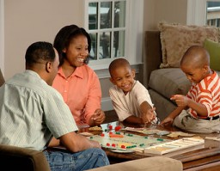
PLAY with NUMBERS
Play board games that involve counting.
Create “word problems” in real life, such as--
“I have 3 cookies. If I give you one, how many will I have left?”
“Who is wearing more bracelets? You, or your sister?”
“Count all the blocks. How many are there?”

Slide 25
Join the Public Library!
MANY fun, educational programs for kids and families
Game Days
Movie Days
Lego Club
Baby Story Time
And much MORE!
Access to WIFI
Use of computers
Help with Resumes
Books, Magazines, E-books
ALL AT NO COST Information on Paulding County Public Libraries is available here.

Slide 26
ACCESS Paulding County School District Website click here
Current events and opportunities
Sign up for free Microsoft Office products
Links to free education resources for students
Policies
and more!

Slide 27
Communication
Newsletters
Parent Teacher Conferences
Automated Phone Messages
Text Messages
School & District Website
Communication Folders
School Events—family events, PTA
Please contact the school with any
questions, concerns, any time!

Slide 28
Would you like to VOLUNTEER?
Please check with your school on opportunities, and on the procedures in place to participate as a volunteer.
Just a friendly reminder, for the safely of all kids, everyone must always check in at the
Front Office before proceeding to any school activity. Volunteer application available here

